Slide 1
LECTURE 24
JOptionPane, Applet and StringTokenizer

Slide 2
JOPTIONPANE
Creates a simple, standard dialog.
Belongs to javax.swing
When JOptionPane is used to implement a dialog, still a JDialog works behind the scenes. The reason is that JOptionPane is simply a container that can automatically create a JDialog and add itself to the JDialog's content pane.

Slide 3
EXAMPLE: READ DATA FROM THE KEYBOARD
import javax.swing.*;
class add_num
{
public static void main(String args[])
{
String f_num, sec_num;
int num1, num2, sum;
f_num = JOptionPane.showInputDialog("Enter First Input:");
sec_num = JOptionPane.showInputDialog("Enter Second Input:");
num1 = Integer.parseInt(f_num);
num2 = Integer.parseInt(sec_num);
sum = num1 + num2;
JOptionPane.showMessageDialog(null,"The sum is: "+sum);
}
}

Slide 4
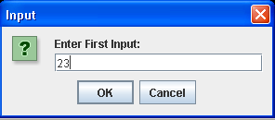
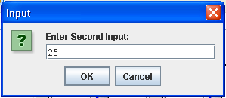
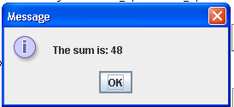
OUTPUT

Slide 5
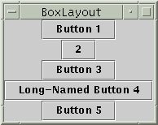
BOXLAYOUT
BoxLayout either stacks its components on top of each other or places them in a row
Belongs to java.awt.
it respects each component's maximum size and X and Y alignment.

Slide 6
APPLET
Applets are small applications that are accessed on an internet server, transported over the internet, automatically installed and run as part of a web document.
It has limited access to the client’s resources.

Slide 7
FIRST APPLET PROGRAM
import java.awt.*;
import java.applet.*;
/*<applet code = “SimpleApplet” width=200 height=60>
</applet>
*/
public class SimpleApplet extends Applet
{
public void paint(Graphics g)
{
g.drawString(“A Simple Applet”, 20, 20);
}
}

Slide 8
IMPORTANT POINTS
All applets are subclass of Applet belonging to java.applet.
All applets run in a window, so include support for that window.(java.awt).
Applets are not executed by the console based java run time interpreter. Rather they are executed by either a web browser or an applet viewer.

Slide 9
IMPORTANT POINTS
paint() is called each time that the applet must redisplay its output.
- a window running an applet can be over written by another window and then uncovered.
- the applet window can be minimized and then restored.
- when the applet begins execution.
The SimpleApplet class must be declared public.
The applet does not have main() method.

Slide 10
STEPS FOR DEVELOPING AND EXECUTING AN APPLET
Edit a java source file (For this example, SimpleApplet.java)
Compile your program ( javac SimpleApplet.java)
Execute the applet viewer, specifying the java source file. (appletviewer SimpleApplet.java)

Slide 11
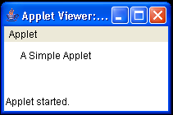
OUTPUT

Slide 12
CHAIN OF CLASSES INHERITED BY APPLET CLASS
java.lang.Object
java.awt.Component
java.awt.Container
java.awt.Panel
java.applet.Applet
paint()

Slide 13
APPLET LIFE CYCLE
Born
Begin
Load Applet
init()
start()
stop()
Running
Idle
Stopped
Display
paint()
start()
destroy()
Dead
Destroyed
End
Exit of Browser

Slide 14
APPLET
Most applets overrides a set of methods:
1. init() 2. start() 3. stop() 4. destroy()----defined by Applet.
5. paint() ---defined by awt.Component.
Applet Initialization:
When an applet begins, the following methods are called:
init() 2. start() 3.paint()
Applet Termination:
1. stop() 2. destroy()

Slide 15
init():
First method to be called.
Initialize variables.
Is called only once during the run time of an applet.
start():
Is called after init().
Is also called to restart an applet after it has been stopped.
paint():
1. This method is called each the applet’s output must be redrawn.

Slide 16
stop():
stop() method is called when the browser leaves the HTML document containing the applet.
destroy():
Is called when the applet needs to be removed completely from the memory.
Free up any resources the applet may be using.
stop() is always called before destroy().
Occurs only once in the lifetime of an applet.

Slide 17
EXAMPLE
import java.awt.*;
import java.applet.*;
/* <applet code = "sample" width=300 height=50>
</applet> */
public class sample extends Applet
{
String msg;
public void init()
{
setBackground(Color.cyan);
setForeground(Color.black);
msg = "Inside init() ---";
}
public void start()
{
msg+=" Inside start() ---";
}
public void paint(Graphics g)
{
msg+=" Inside paint().";
g.drawString(msg, 10, 30);
}
}

Slide 18
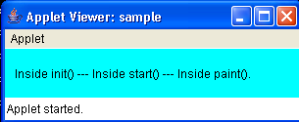
OUTPUT

Slide 19
APPLET USING SWING
A swing applet extends JApplet which is derived from Applet.
Japplet is a top-level Swing container.
Swing applets use the same four lifecycle methods: (1) init() (2) start (3) stop (4) destroy().
All interaction with components in a swing applet must take place on the event dispatching thread.

Slide 20
EVENT DISPATCHING THREAD
Swing code of your program run on event dispatch thread.
Uses two methods that are defined in SwingUtitlities class:
Static void invokeLater(Runnable obj)
Static void invokeAndWait(Runnable obj)
throws InterruptedException, InvocationTargetException

Slide 21
EXAMPLE
import javax.swing.*;
import java.awt.*;
import java.awt.event.*;
import java.awt.Container;
/*<applet code="test_applet2" width=300 height=200>
</applet>
*/
public class test_applet2 extends JApplet
{
JButton alpha;
JButton beta;
JLabel jlab;
public void init(){
try{
SwingUtilities.invokeAndWait(new Runnable(){
public void run(){
makeGUI();
}
});
}
catch(Exception exc)
{
System.out.println("Cannot Create because of "+exc);
}
}

Slide 22
EXAMPLE
void makeGUI()
{
setLayout(new FlowLayout());
alpha=new JButton("Alpha");
beta=new JButton("Beta");
Container content=getContentPane();
alpha.addActionListener(new ActionListener(){
public void actionPerformed(ActionEvent e){
jlab.setText("Alpha was pressed");
}
});
beta.addActionListener(new ActionListener(){
public void actionPerformed(ActionEvent e){
jlab.setText("Beta was pressed");
}
});
content.add(alpha);
content.add(beta);
jlab=new JLabel("Press a button.");
content.add(jlab);
}
}

Slide 23
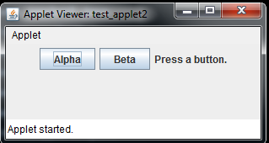
OUTPUT

Slide 24
STRINGTOKENIZER
Belongs to java.util.
Used to parse a formatted input string.
It implements Enumeration interface.
To use this class we need an input string and a string that contains delimiters.
Constructors:
StringTokenizer(String str);
StringTokenizer(String str, String delimiter);
StringTokenizer(String str, String delimiter, boolean delimAsToken)
Default delimiters are space, tab, newline and carriage return.

Slide 25
EXAMPLE
import java.util.*;
class st_demo
{
static String in = "Title = Java: The Complete Reference;"+
"author = Schieldt;"+
"publisher = Osborne/McGraw-Hill;"+
"copyright = 2005";
public static void main(String args[])
{
StringTokenizer st = new StringTokenizer(in, "=;");
while(st.hasMoreTokens())
{
String key = st.nextToken();
String val = st.nextToken();
System.out.println(key+"\t"+val);
}
}
}

Slide 26

OUTPUT

